Slide 1




Ministry of Higher Education and Scientific Research Carthage University National Institute of Applied Sciences and Technology
Graduation Project
Development of a tool for phishing detection
using Machine Learning
Presented by:
Mehdi MASRI
University Supervisor: Mr. Bassem BEN SALAH
Reviewer:
Mr. Souheib YOUSSFI
President of the jury:
Mr. Mondher LAABIDI
Company Supervisor: Mr. Seifeddine TATAR
Notes:
Greetings dear audience
I would like to thank you for the interest you have shown in my work by accepting to be part of the jury. I want to also thank
my insat supervisor Mr Bassem Ben SALAH and company supervisor Mr Seifeddine Tatar

Slide 2


Conclusion and
Future work
Implementation
Specifications and
Architecture of the solution
Machine Learning
As an anti-phishing
solution
Introduction
Notes:
We will start by an introduction where we will present the context of this project and the hosting company
In a second place we have machine learning as an anti-phishing solution in this section we will present the AI part in our project
We will follow that by the specification and architecture of the solution
The fourth section will be dedicated for the implementation and we will finalize by a conclusion and future work

Slide 3
INTRODUCTION

Slide 4
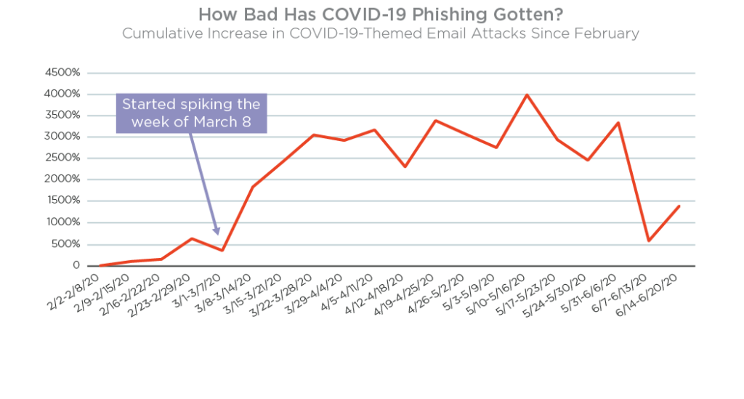
Introduction
Machine Learning As an anti-phishing
solution
Specifications and architecture of the solution
Implementation
Conclusion and
Future work
By Agari a Trusted Email Identity Company, protecting brands and people from devastating phishing and socially-engineered attacks.
1
Notes:
This is a statistic showing the increase of the number of phishing email over the first half of 2020. This increase is exponential as it reach 4000% increase in Mid ma
This statistic was provided by Agari Trusted Email Identity Company, protecting brands and people from devastating phishing and socially-engineered attacks.

Slide 5
Introduction
Machine Learning As an anti-phishing
solution
Specifications and architecture of the solution
Implementation
Conclusion and
Future work
Google has registered 2,145,013
phishing sites as of January 17, 2021, an increase of 27 %
2
Notes:
Not only the phishing emails has seen and increase but also phishing websites google has registered over 2,1 M phishing sites of mid January 2021 an increase of 27%

Slide 6
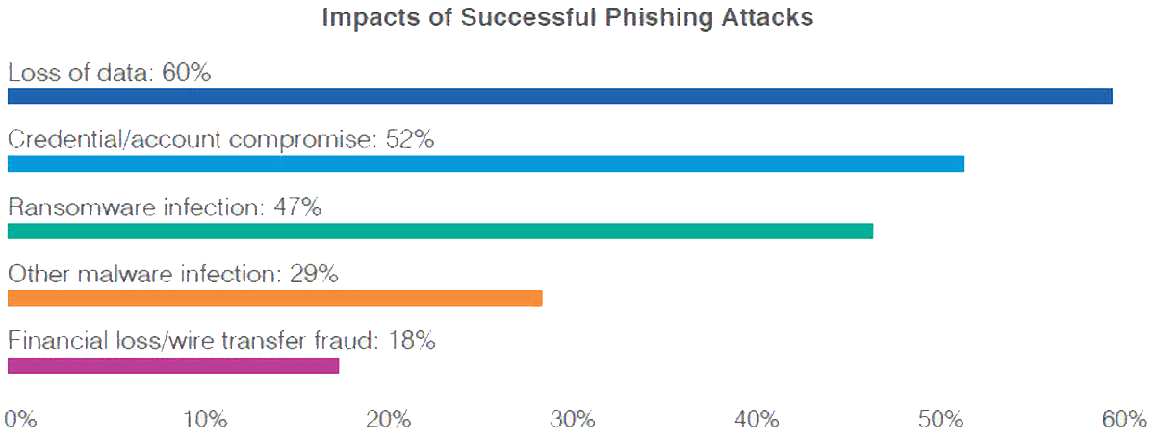
Introduction
Machine Learning As an anti-phishing
solution
Specifications and architecture of the solution
Implementation
Conclusion and
Future work
By TechRepublic an online trade publication and social community for IT professionals
3
Notes:
A successful phishing attack can impact an organization in several ways. Data loss was the greatest side effect, cited by an average of 60% among those surveyed. Compromised accounts or credentials was the second biggest effect, mentioned by 52% of the respondents. Additional outcomes from a phishing attack included ransomware infections as cited by 47%, other malware infections by 29%, and financial loss or wire transfer fraud by 18%.
In this context that we have achieved our graduation project in Netcom

Slide 7

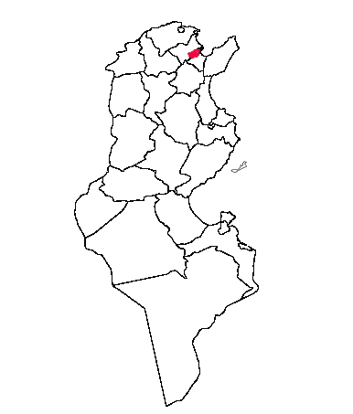



Introduction
Machine Learning As an anti-phishing
solution
Specifications and architecture of the solution
Implementation
Conclusion and
Future work
Located in Tunis
Founded in 1992
The first IP network integrator in Tunisia
A Capital of 1100 000 DT​
Several clients
4
Notes:
Netcom is the first IP network integrator in Tunisia it was founded in 1992 with a capital of over 1100 000 dt and several important clients like BIAT, tijari bank and Central university

Slide 8

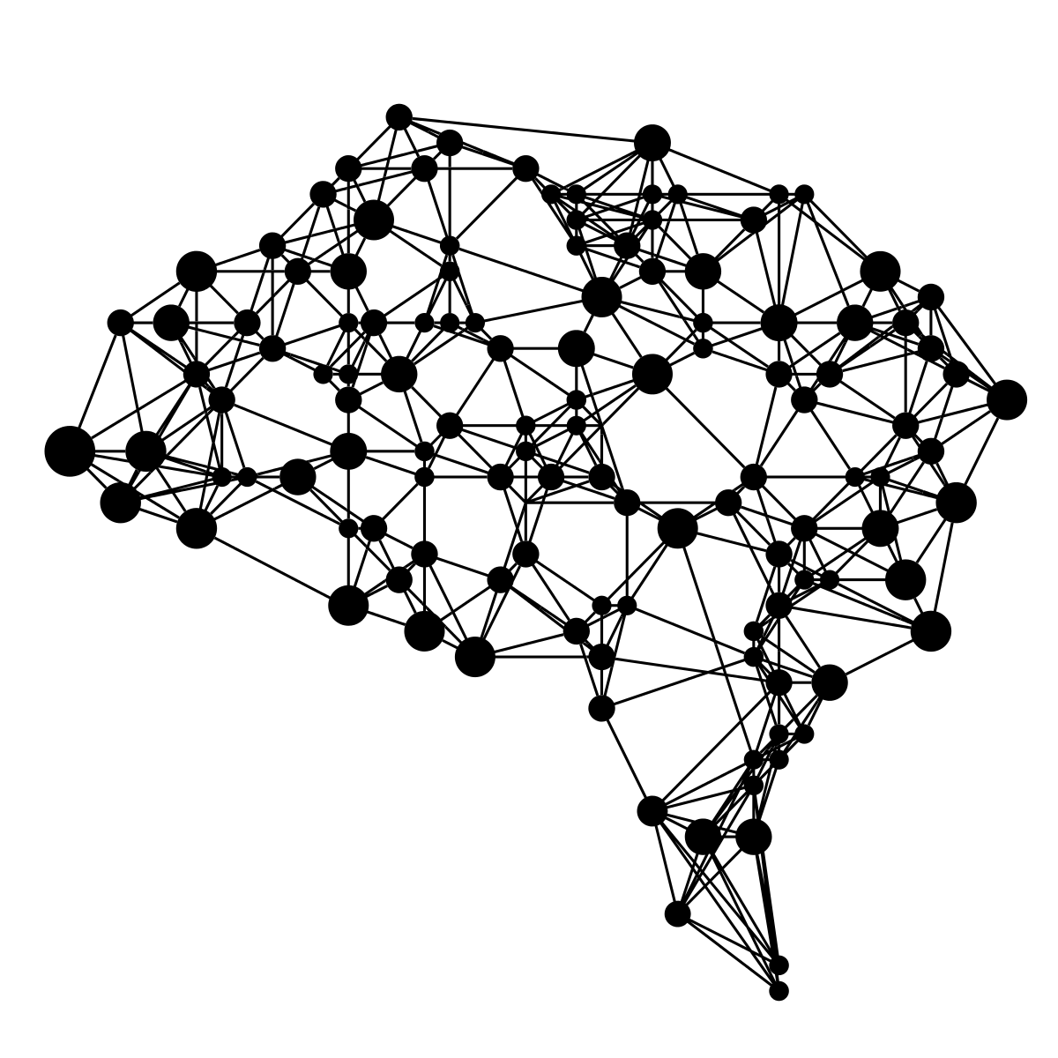


6
Notes:
Using the appropriate data and the Artificial intelligence models we can come up with a solution that can help solve this problem

Slide 9
6

Slide 10
Machine Learning as an anti-phishing solution

Slide 11

Key words definition
Introduction
Machine Learning As an anti-phishing
solution
Specifications and architecture of the solution
Implementation
Conclusion and
Future work
Phishing is a type of social engineering where an attacker sends a fraudulent message designed to trick a human victim into revealing sensitive information
7

Slide 12

Introduction
Machine Learning As an anti-phishing
solution
Specifications and architecture of the solution
Implementation
Conclusion and
Future work
Our work concerning the Machine Learning was based on a research paper. We aimed to give more credit to our solution by doing this.
8
Notes:
In the following slides we will elaborate more and highlight our contribution

Slide 13


Introduction
Machine Learning As an anti-phishing
solution
Specifications and architecture of the solution
Implementation
Conclusion and
Future work
DATASET SOURCE
9
Notes:
PhishTank is an anti-phishing site. The website offers a community-based phish verification system where users submit suspected phishes and other users "vote" if it is a phish or not.
We used it for extracting recent phishing websites in order to make our model up to date.
For the legitimate website we used alexa top 1 million websites for collection top ranked websites that are trusted by the internet community

Slide 14


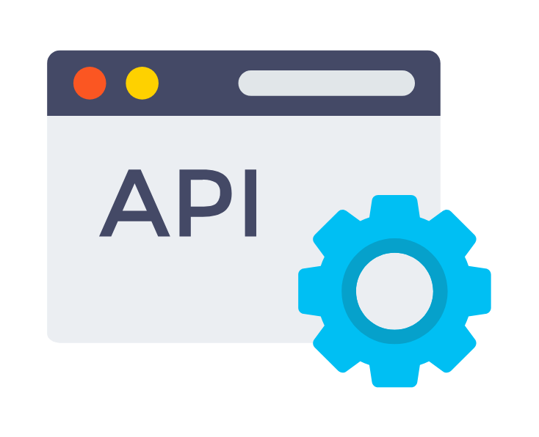
Introduction
Machine Learning As an anti-phishing
solution
Specifications and architecture of the solution
Implementation
Conclusion and
Future work
Processing data
0
1
0
.
.
.
1
1
1
Raw data URL/HTML
10
Notes:
Obviously, we can’t feed raw data to our model. The data that we have collected should be first processed and transformed to a format that the neural network is able to process.
We will be preprocessing the url, html code and we will use some API to collect more features necessary for our dataset

Slide 15

Introduction
Machine Learning As an anti-phishing
solution
Specifications and architecture of the solution
Implementation
Conclusion and
Future work
Feature based on URL
Feature based on HTML
Dataset
Feature based on Domain
Feature based on Page
11
Notes:
The desired data set contains 30 features which can be divided into 4 categories

Slide 16
Introduction
Machine Learning As an anti-phishing
solution
Specifications and architecture of the solution
Implementation
Conclusion and
Future work
-1
Legitimate tendency
Faceb-ook instead of Facebook
Prefix suffix
1
phishing tendency
Feature based on URL
-1
Legitimate tendency
Multiple subdomains
0
suspicious
12
1
phishing tendency
Notes:
Transforming the raw data into the appropriate values was based on several statistics for example in we found that suffix and prefix are commonly used by phisher
For example pay-pal instead of Paypal
Also, we have noticed that phishing websites have a tendency to use more subdomain than legitimate one so we attributed the following values
-1 if there is one sub
0 suspcipous there are two subdoamins
1 phishing tendency three or more

Slide 17
Introduction
Machine Learning As an anti-phishing
solution
Specifications and architecture of the solution
Implementation
Conclusion and
Future work
Using Iframe
Feature based on HTML
Using Pop-up Window
13
Notes:
Using iframe which is a html tag that enables the phisher to use a frame inside the original webpage
Popup windows that contains fields asking the users for sensitive information

Slide 18
Introduction
Machine Learning As an anti-phishing
solution
Specifications and architecture of the solution
Implementation
Conclusion and
Future work
Domain creation date
Feature based on domain
TLS/SSL state
14
Notes:
Generally phishing urls do not live for a long and they are most likely recently created this is can be used as a good feature
TLS state we will not be simply checking whether the website uses https or not we will be also checking the entity that issued the certificated and if it was actually issued to the website domain

Slide 19
Introduction
Machine Learning As an anti-phishing
solution
Specifications and architecture of the solution
Implementation
Conclusion and
Future work
Page Rank
Feature based on page
Google Index
15
Notes:
Page rank a score from 0 to 10 attributed by google depending how Populaire is the website and other factors
Google index whether the website was indexed by google or not

Slide 20
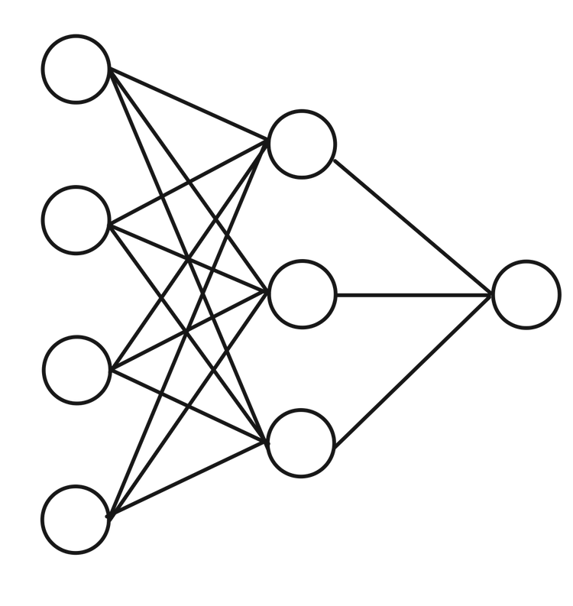
Introduction
Machine Learning As an anti-phishing
solution
Specifications and architecture of the solution
Implementation
Conclusion and
Future work
Training and optimization of the model
0
1
0
.
.
.
1
1
1
1
0
1
0
.
.
.
1
0
1
1
0
1
0
.
.
.
1
0
-1
1
0 1 0 1 0 0 1
16
Notes:
After training and optimizing the parameters of the neural network that I have created I ve reach an accuracy of

Slide 21
Accuracy 97,8 %
Introduction
Machine Learning As an anti-phishing
solution
Specifications and architecture of the solution
Implementation
Conclusion and
Future work
The accuracy alone is not enough. The execution time is important too
17

Slide 22
Introduction
Machine Learning As an anti-phishing
solution
Specifications and architecture of the solution
Implementation
Conclusion and
Future work
0
1
0
.
.
.
1
1
1
Raw data URL/HTML
0/1
11 seconds
18
Notes:
The most time-consuming task is the feature extraction as it takes and average of 11 seconds to complete while the inference time of the model is in the order of milliseconds

Slide 23
To improve the performance, we have worked on three axes
Number of features
Architecture of the solution
How code is executed
19

Slide 24

Introduction
Machine Learning As an anti-phishing
solution
Specifications and architecture of the solution
Implementation
Conclusion and
Future work
Sequential programming
vs
Concurrent programming
This means rewriting the code
Multi-Threading
Multi-Processing
20
Notes:
Concurrent programing offers several advantages over sequential programing. We decided to use concurrent programing as it offers faster execution time
Multi threading allows as to run and manage multiple threads which are light weight process sharing same space
Multi processing allows us to run and manage multiple process heavier than en resources and independent from each others

Slide 25

Introduction
Machine Learning As an anti-phishing
solution
Specifications and architecture of the solution
Implementation
Conclusion and
Future work
Multi-Processing
The Python Global Interpreter Lock or GIL, in simple words, is a mutex (or a lock) that allows only one thread to hold the control of the Python interpreter.
21
Notes:
The difference is that threads run in the same memory space, while processes have separate memory. This makes it a bit harder to share objects between processes with multiprocessing. Since threads use the same memory, precautions have to be taken or two threads will write to the same memory at the same time.

Slide 26
Introduction
Machine Learning As an anti-phishing
solution
Specifications and architecture of the solution
Implementation
Conclusion and
Future work
Sidestepping the Global Interpreter Lock by using Multi-processing instead of Multi-threading.
This will ensure TRUE concurrency between the executing functions
Reduced the time to an average of 6 seconds
22

Slide 27
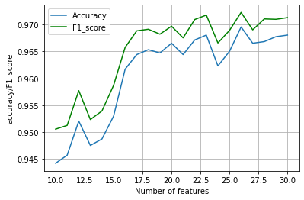
Introduction
Machine Learning As an anti-phishing
solution
Specifications and architecture of the solution
Implementation
Conclusion and
Future work
Influence of number of features on the accuracy
Features ranked based on information gain metric
23
Notes:
To reduce the execution time we have decided to work on the number of features that will be used by the neural network
We have ranked our features based on the information gain metric. Each time we took the top ranking features and we have trained the model by only using them we started by training the top 10 features than each time we incremented by one and retrained the model until reaching 30. Then we were able to plot the following plot.

Slide 28
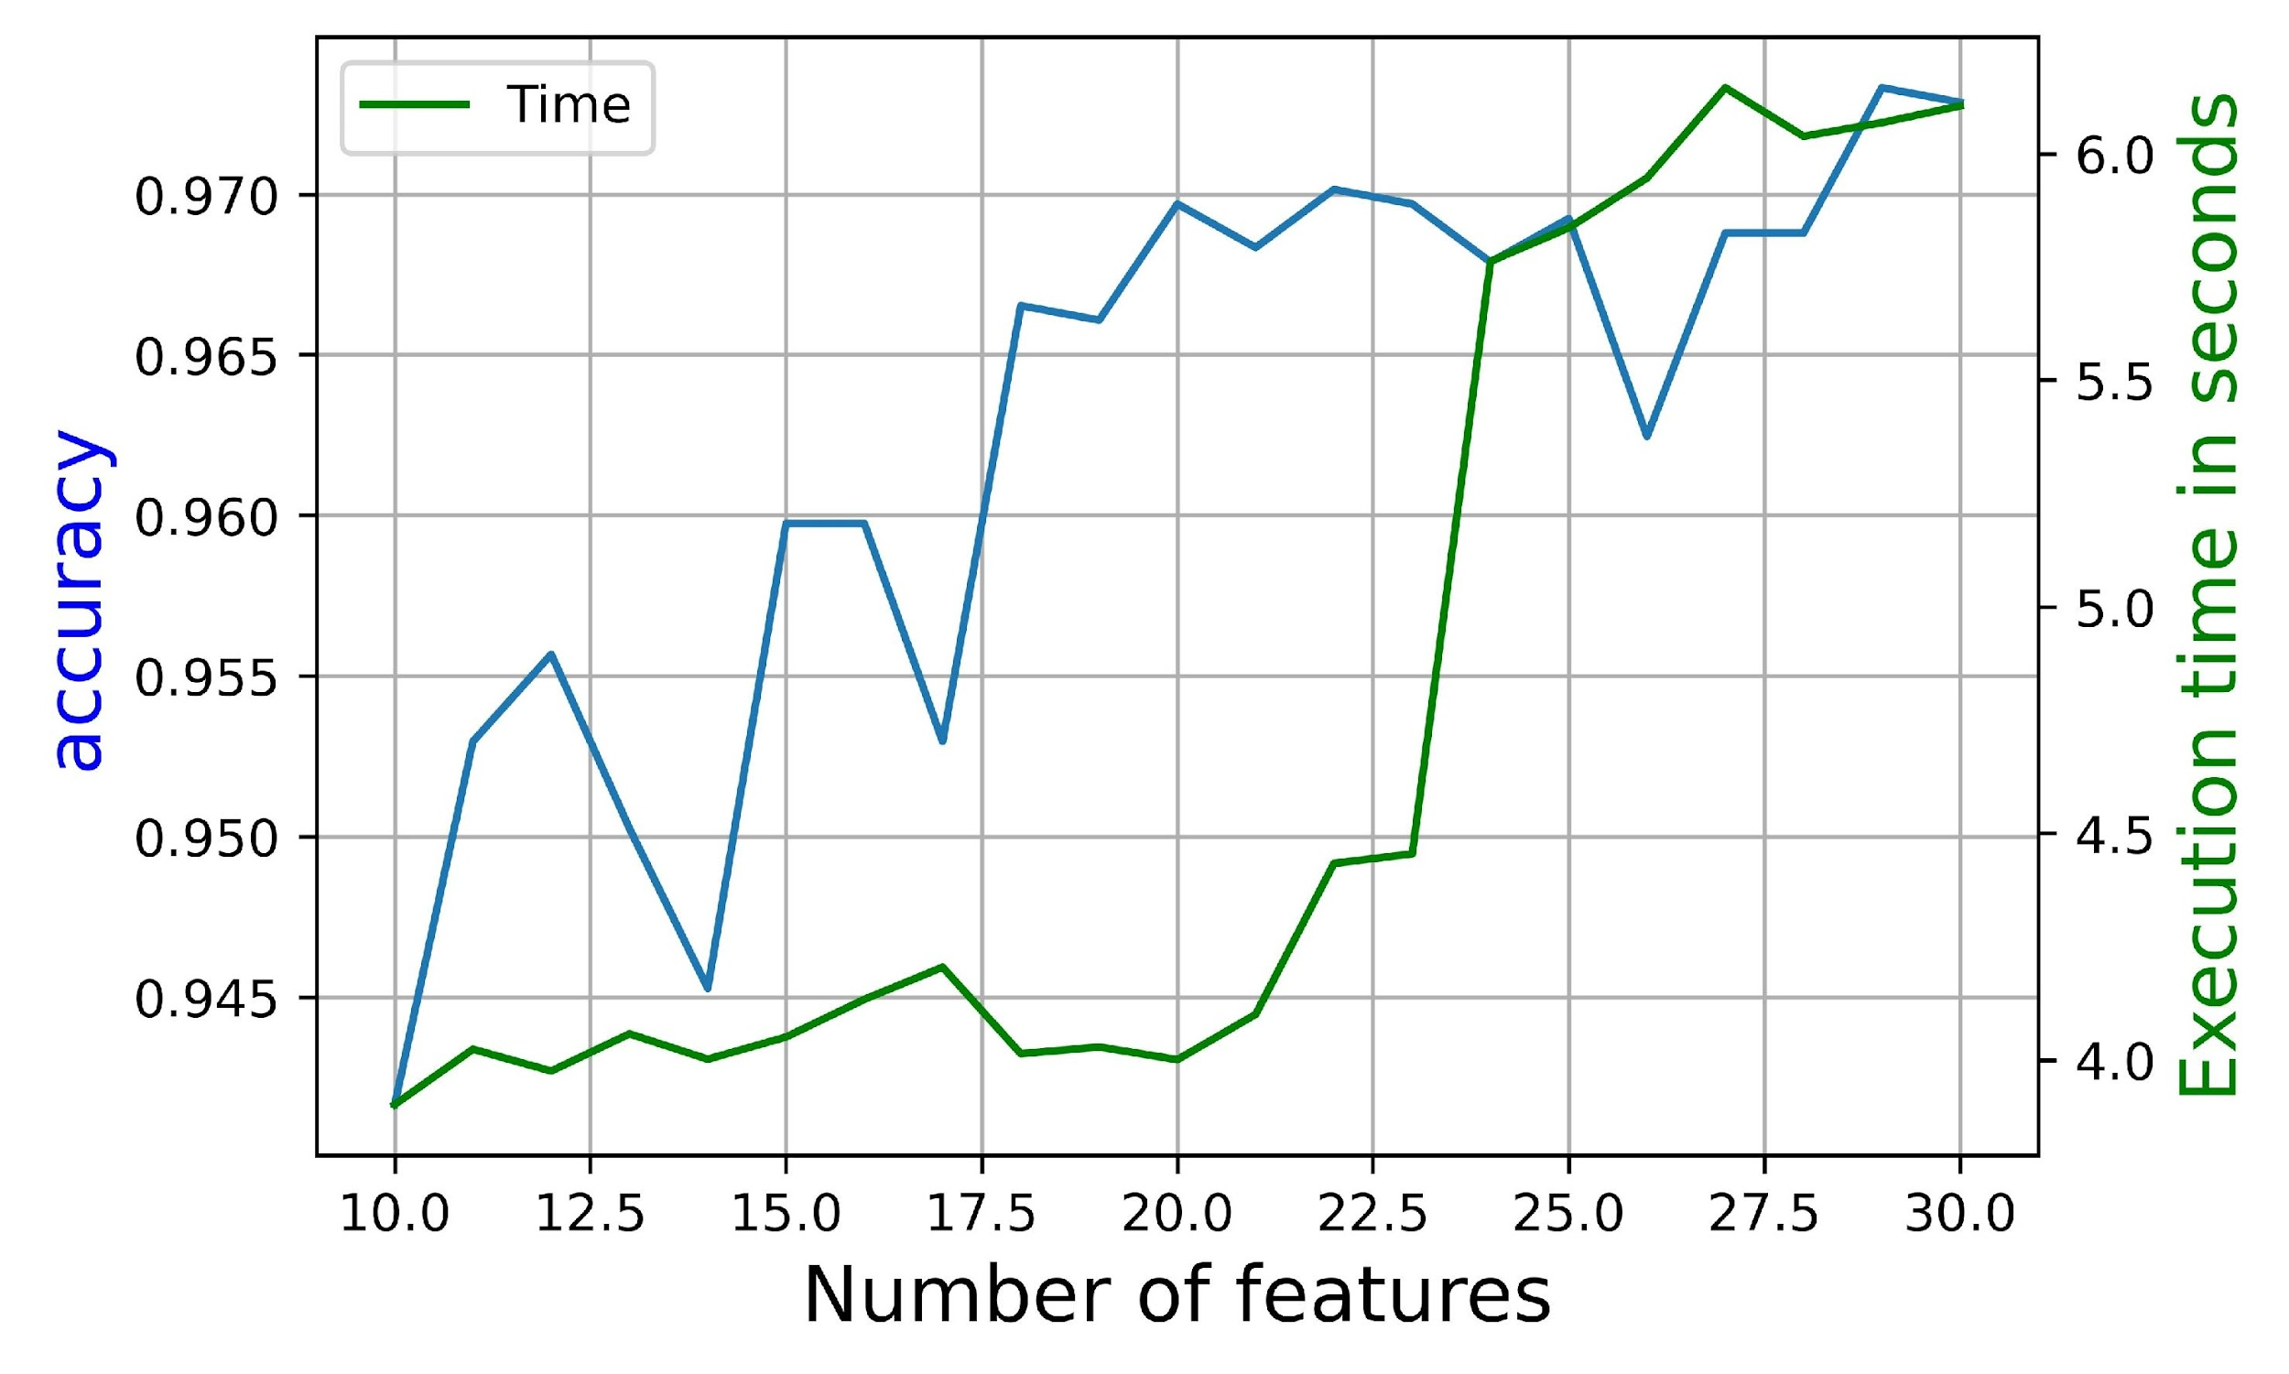
Introduction
Machine Learning As an anti-phishing
solution
Specifications and architecture of the solution
Implementation
Conclusion and
Future work
Trade-off between Time and accuracy
97%
4 seconds
24
Notes:
We than added the average features extraction time for each set of features to find a trade-off between accuracy and execution time.
The best trade-off is at 20 feat with around 97% accuracy and 4s execution time

Slide 29
Introduction
Machine Learning As an anti-phishing
solution
Specifications and architecture of the solution
Implementation
Conclusion and
Future work
Accuracy 97,4 %
4 seconds
25

Slide 30
Specification and architecture
Prediction

Slide 31
Visualization
Introduction
Machine Learning As an anti-phishing
solution
Specifications and architecture of the solution
Implementation
Conclusion and
Future work
Functional specifications
Prediction
26
Notes:
Our solution should provide high accuracy with low false positive

Slide 32
Storage
Introduction
Machine Learning As an anti-phishing
solution
Specifications and architecture of the solution
Implementation
Conclusion and
Future work
Functional specifications
Visualization
Prediction
26
Notes:
Good visualization to monitor the activities of the user

Slide 33

Modularity
Introduction
Machine Learning As an anti-phishing
solution
Specifications and architecture of the solution
Implementation
Conclusion and
Future work
Functional specifications
Storage
Visualization
Prediction
26
Notes:
Storage to store data coming from the user

Slide 34
Performance
Introduction
Machine Learning As an anti-phishing
solution
Specifications and architecture of the solution
Implementation
Conclusion and
Future work
Functional specifications
Modularity
Storage
Visualization
Prediction
26
Notes:
Our solution must ensure modularity easy upgrades of the component of the solution

Slide 35
Ergonomics
Introduction
Machine Learning As an anti-phishing
solution
Specifications and architecture of the solution
Implementation
Conclusion and
Future work
Non-functional specifications
Performance
27

Slide 36
Documentation
Introduction
Machine Learning As an anti-phishing
solution
Specifications and architecture of the solution
Implementation
Conclusion and
Future work
Non-functional specifications
Ergonomics
Performance
27

Slide 37
Introduction
Machine Learning As an anti-phishing
solution
Specifications and architecture of the solution
Implementation
Conclusion and
Future work
Non-functional specifications
Documentation
Ergonomics
Performance
27

Slide 38
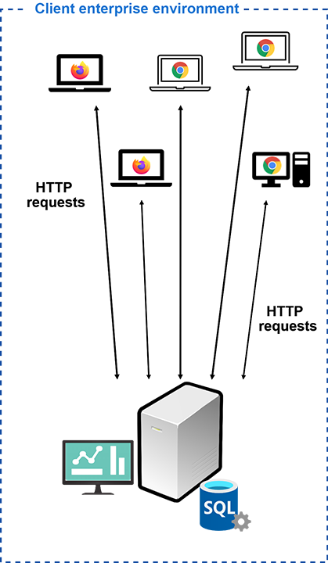

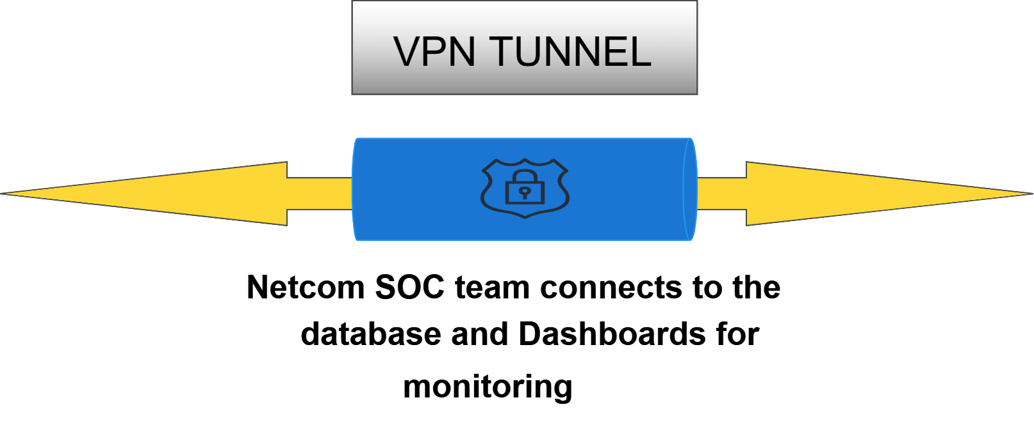
Notes:
Our solution will be integrated with netcom SOC center. This connection will be esured via a secure VPN Tunnel to ensure security and integrity of the data
Our solution will be integrated in the client enterprise environment

Slide 39
Basic architecture of our solution
28
Notes:
We have two main components are the back-end server that will host the machine learning module and the rest api and other components that we have used
The second components will be a plugin that will be installed in the computers of the employees of the client company

Slide 40
Implementation

Slide 41










Technologies used in the development process
29

Slide 42
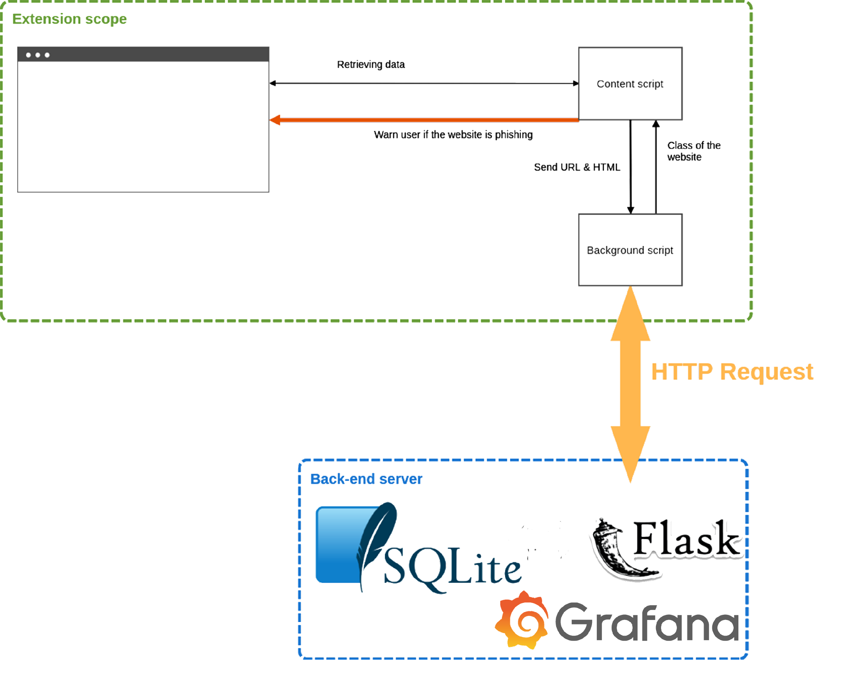

Introduction
Machine Learning As an anti-phishing
solution
Specifications and architecture of the solution
Implementation
Conclusion and
Future work
30

Slide 43





HTTP Request
API built with Flask
receives and dispatches
Json
31

Slide 44

Introduction
Machine Learning As an anti-phishing
solution
Specifications and architecture of the solution
Implementation
Conclusion and
Future work
Decision maker
4
Doesn’t exist in both tables
If doesn’t exists
Feature extraction
3
Trained Neural Network
3
If doesn’t exists
2
Whitelist table
URL predicted
1
Prediction
Store result in URL predicted
2
3
API built with Flask
receives and dispatches
Json
If exists
If exists
Result
Result
Result
32

Slide 45
HTTP Request
API built with Flask
receives and dispatches
Json
33

Slide 46

Grafana provides its own authentication mechanism. Also, Grafana provides the possibility to connect with another authentication mechanism
34

Slide 47
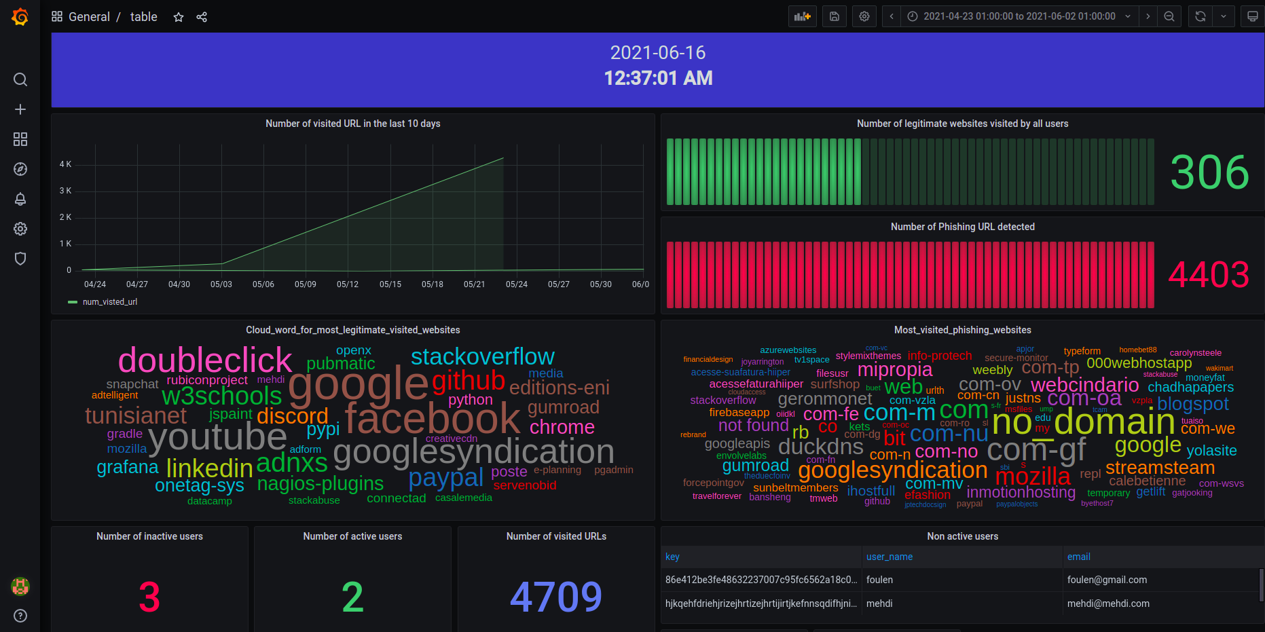
35

Slide 48
Introduction
Machine Learning As an anti-phishing
solution
Specifications and architecture of the solution
Implementation
Conclusion and
Future work
36

Slide 49
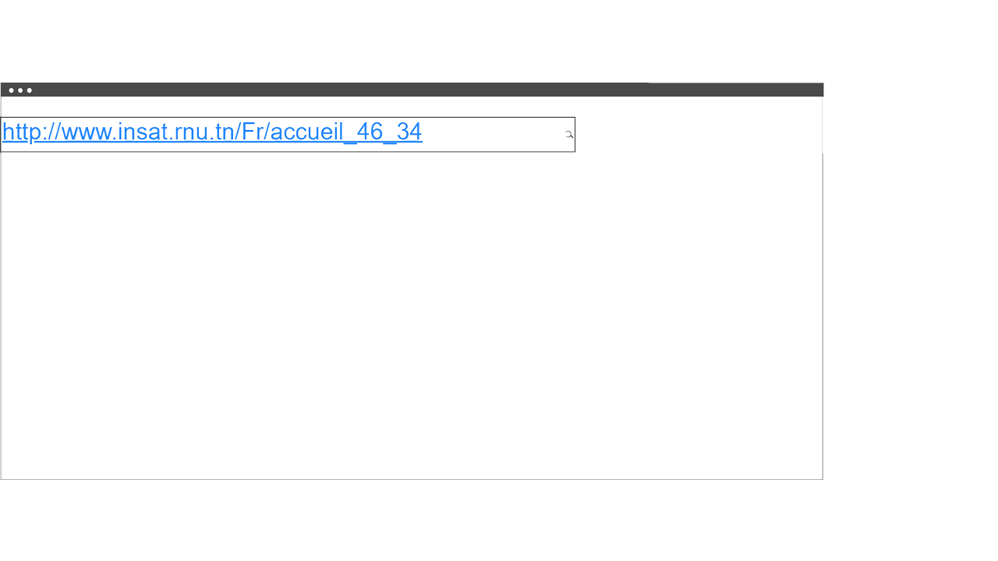
Retrieving data
Content Script
Warn user if URL is phishing
Send URL/HTML
Class of the website
Background Script
37

Slide 50
Conclusion and Future work

Slide 51
High accuracy and fast execution time
Ergonomic visualization
Data storage
A functional plugin that can be added on both Mozilla and Chrome
38

Slide 52
Introduction
Machine Learning As an anti-phishing
solution
Specifications and architecture of the solution
Implementation
Conclusion and
Future work
Future work
Dockerisation of the back-end server
Automating the process of plugin creation
More security features by encrypting the HTTP traffic
39

Slide 53
Thank you for your attention

